Slide 1

Capstone Project 2
By : Ng jing wen

Slide 2
Where I get my data from
data.gov.sg
WHO
Global dietary database

Slide 3
Objective
Increasing trend of obesity rates
What are the cause(s)
What if we ignore the current situation
What are the effects (Economically / Socially)
Solutions to help

Slide 4
Business questions
Obesity increasing in developed countries?
Causes for obesity
Is obesity causing an increased in spending for Singapore?
Are Singaporeans living an active lifestyle?
Leading more Singaporeans to adopt an active lifestyle

Slide 5
What is obesity and why is it an issue
Overweight and obesity are defined as abnormal or excessive fat accumulation that presents a risk to health. A body mass index (BMI) over 25 is considered overweight, and over 30 is obese.
From 1975 to 2016, the prevalence of overweight or obese children and adolescents aged 5–19 years increased more than four-fold from 4% to 18% globally.

Slide 6
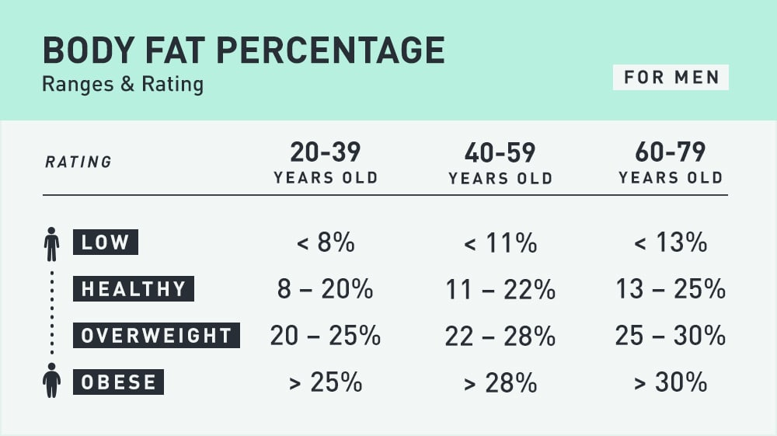
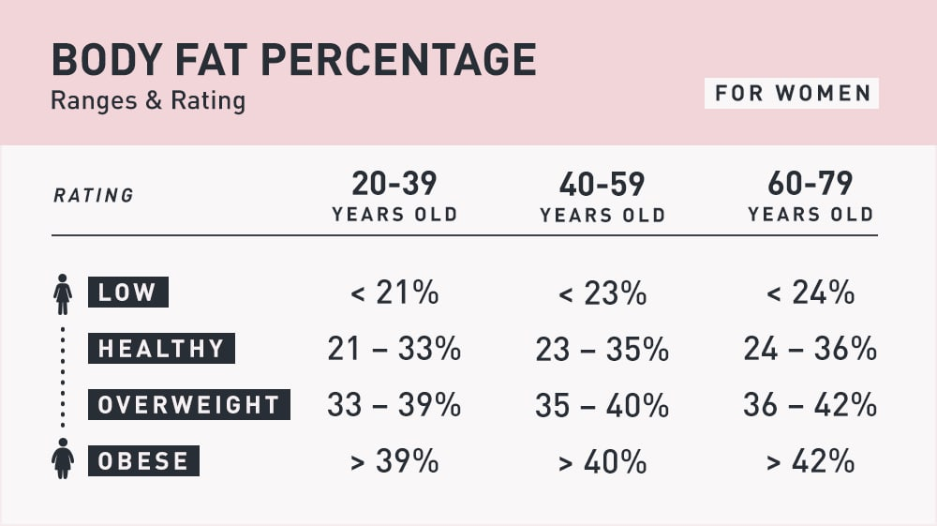

Slide 7
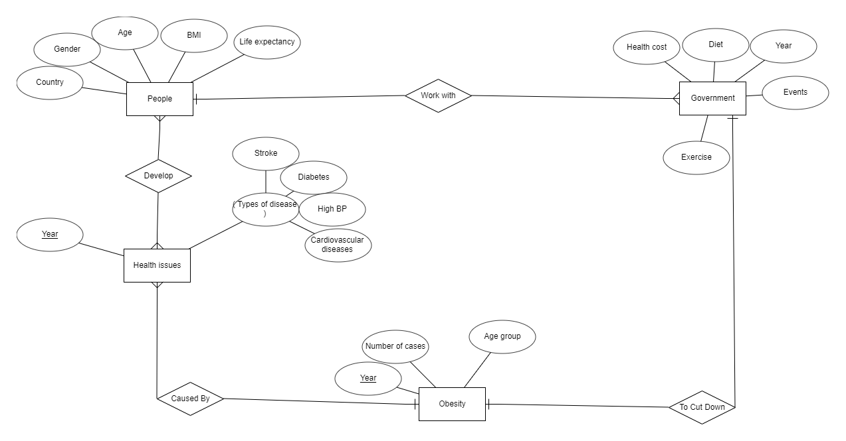

Slide 8
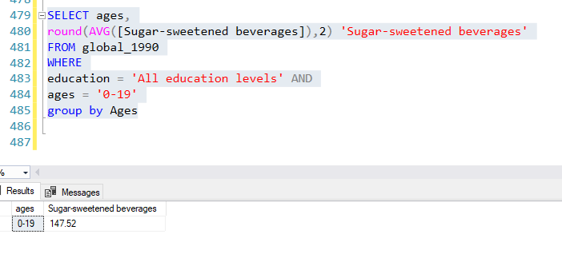
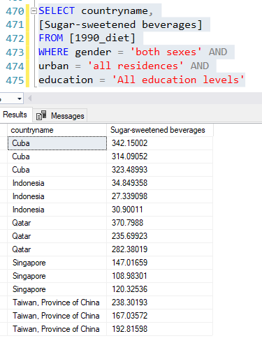
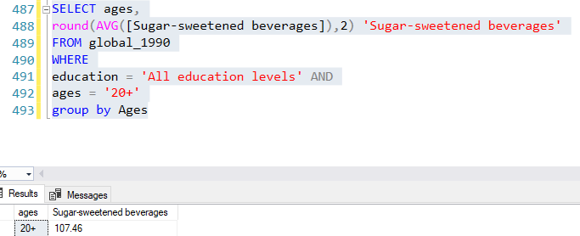

Slide 9
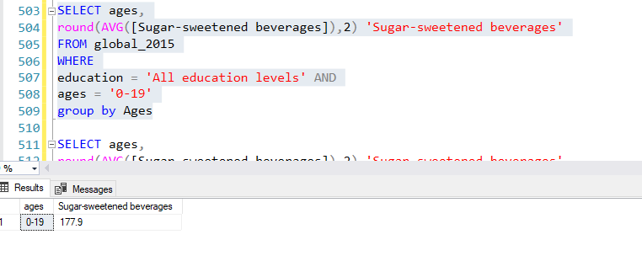
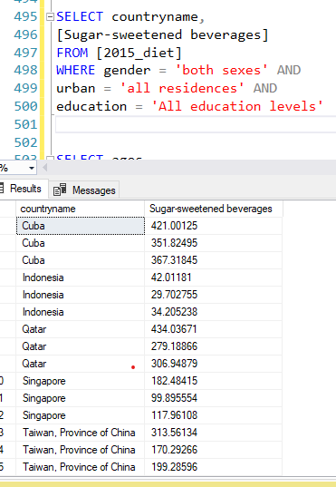
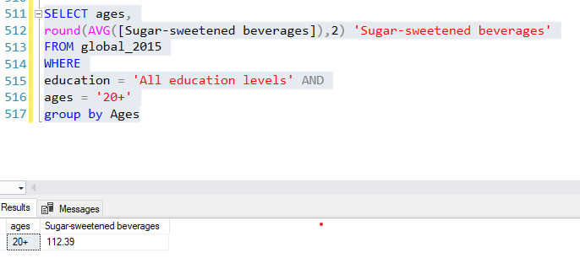

Slide 10
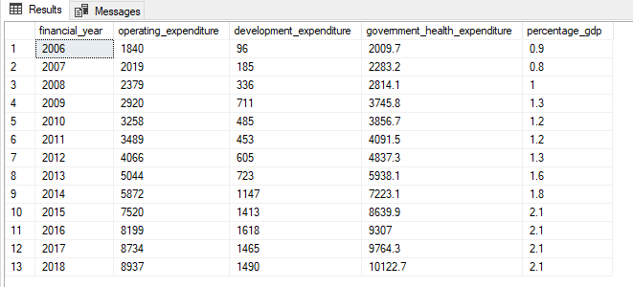
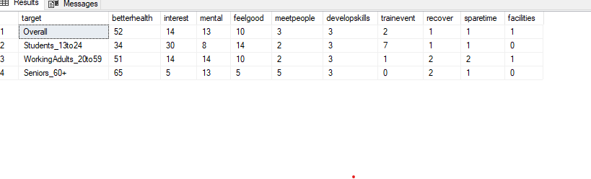

Slide 11
Conclusion
Lesser children are going outside to play or socialise
The earning power of population enable us to eat tastier food which are not necessarily healthier for us
We should cut down on sweet beverages

